Slide 2
Oh! Oh!

Slide 3
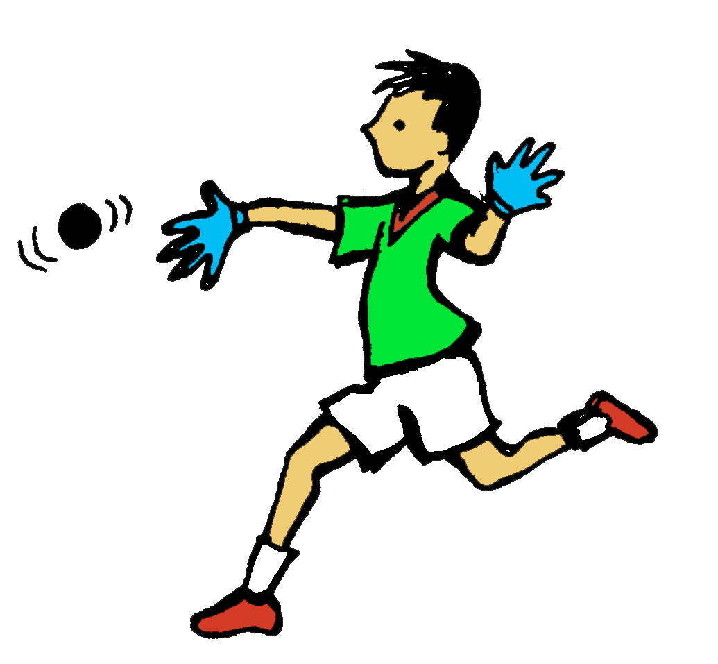
From the nations we have come for this,
from the corners of the Earth.

Slide 4
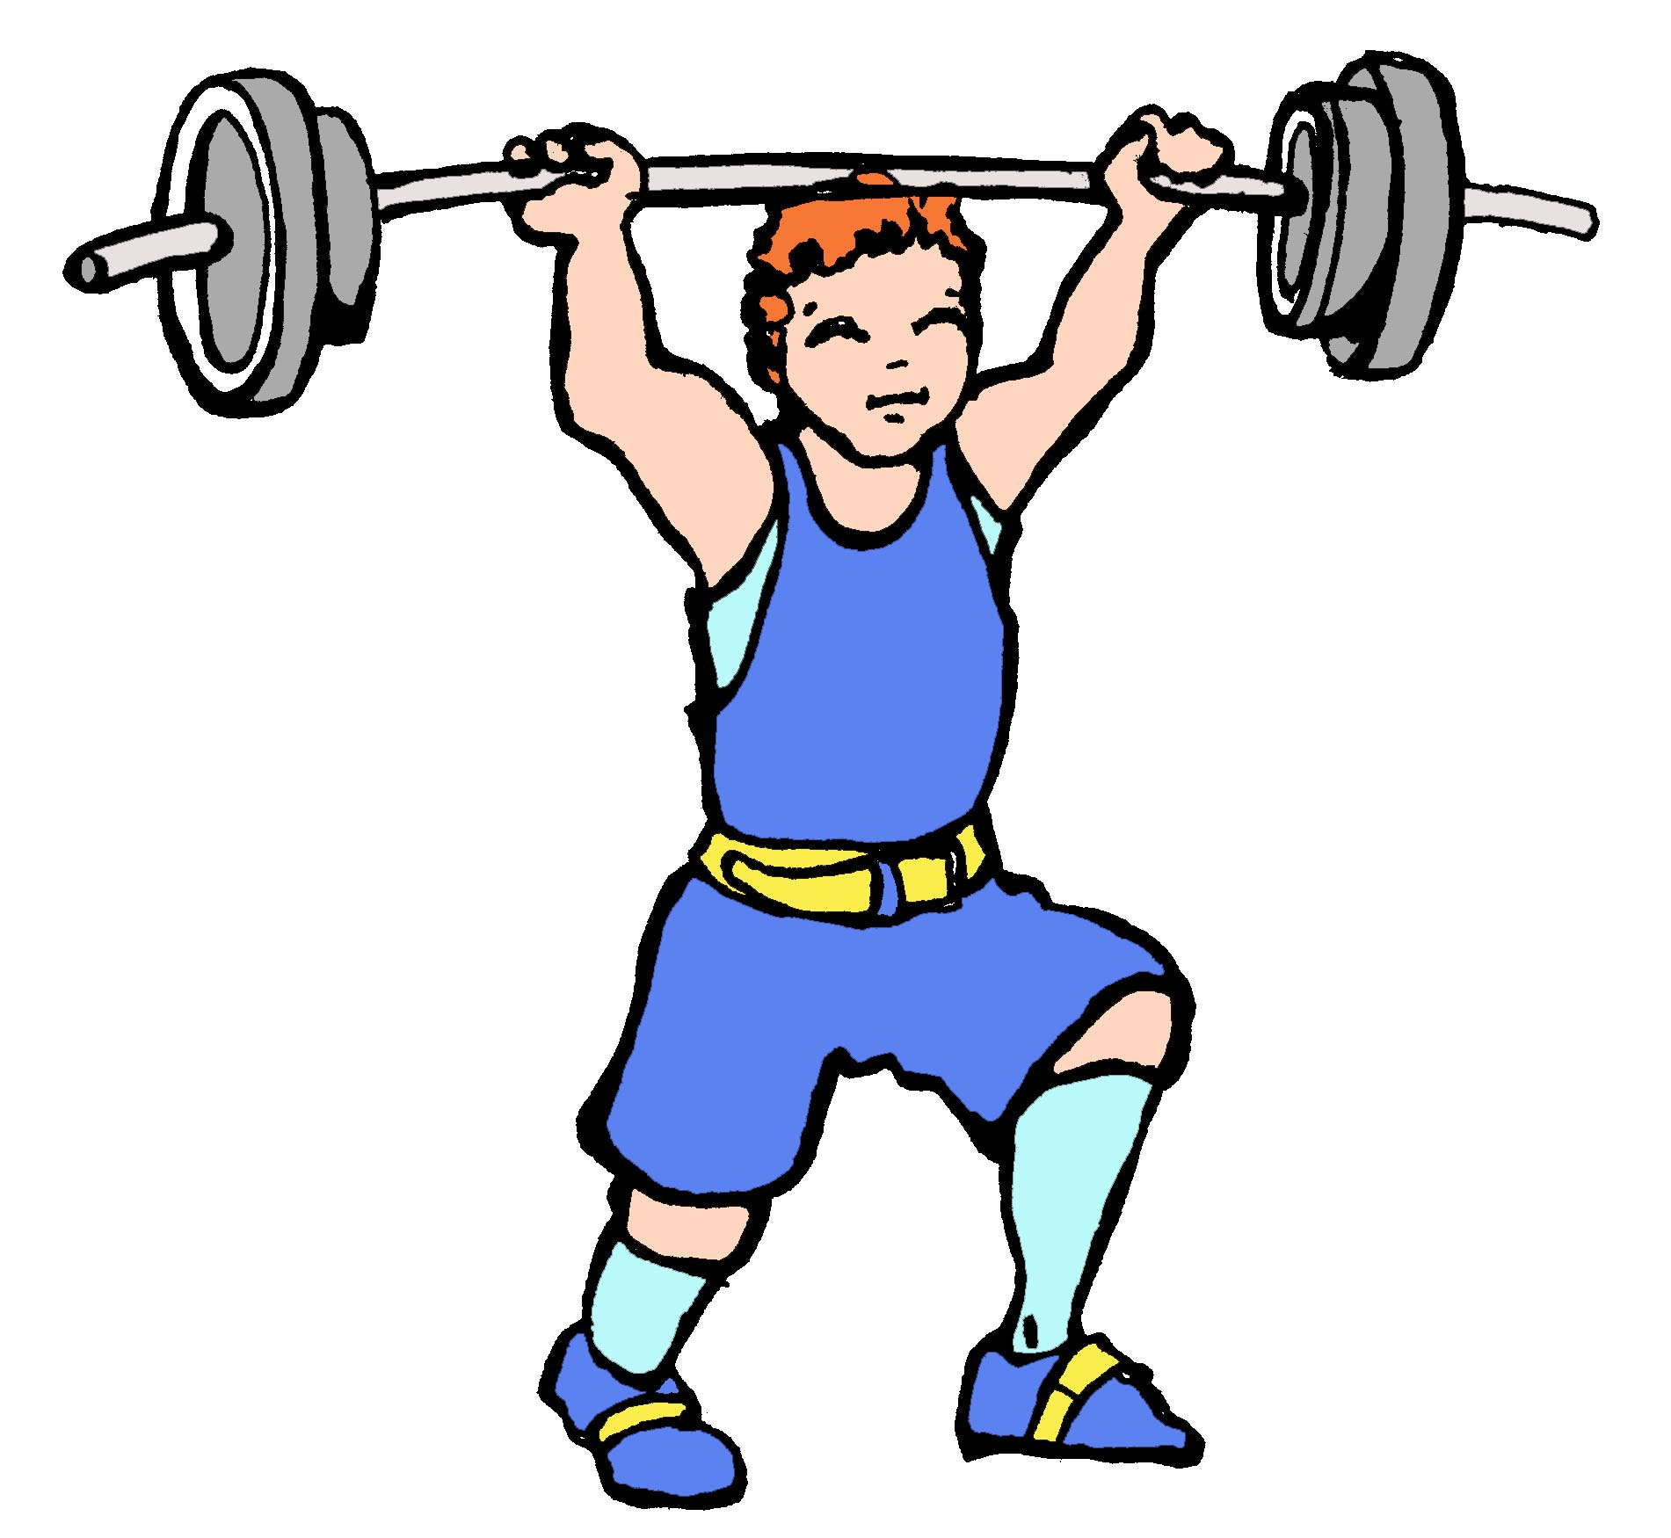
We will push the limits of our strength.

Slide 5
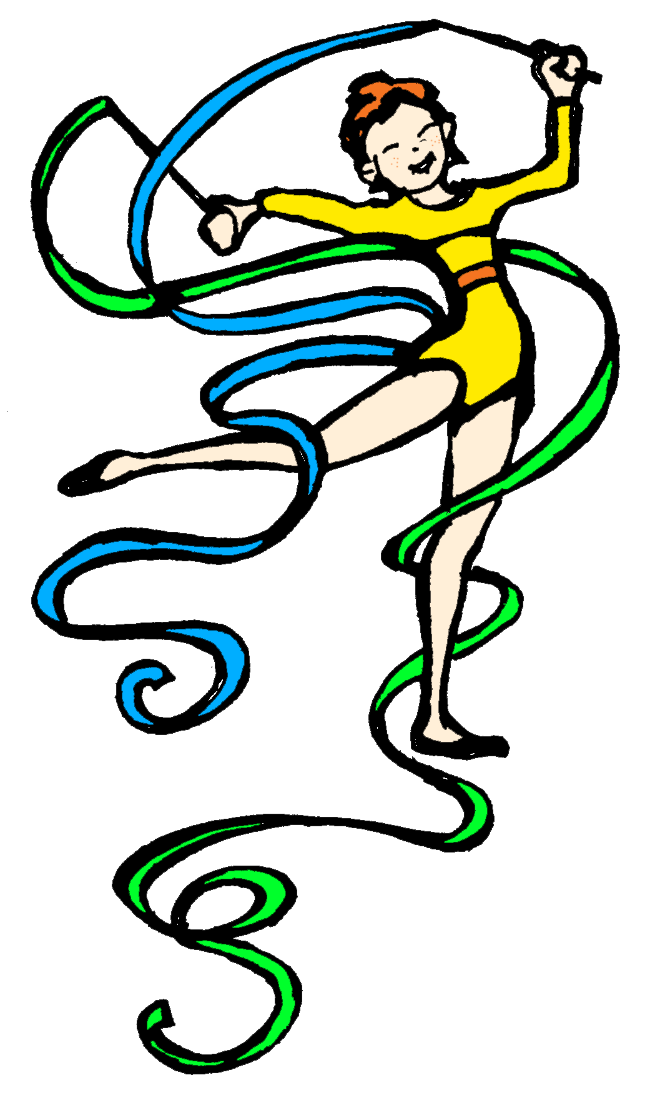
We will give it all it’s worth.

Slide 6
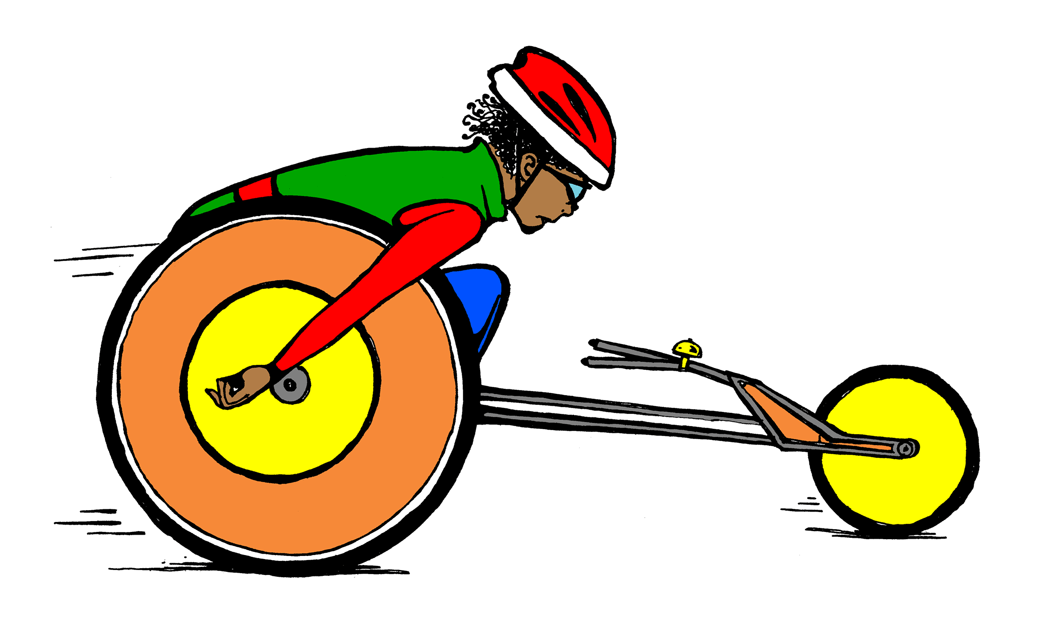
We are training smarter. Growing stronger.

Slide 7
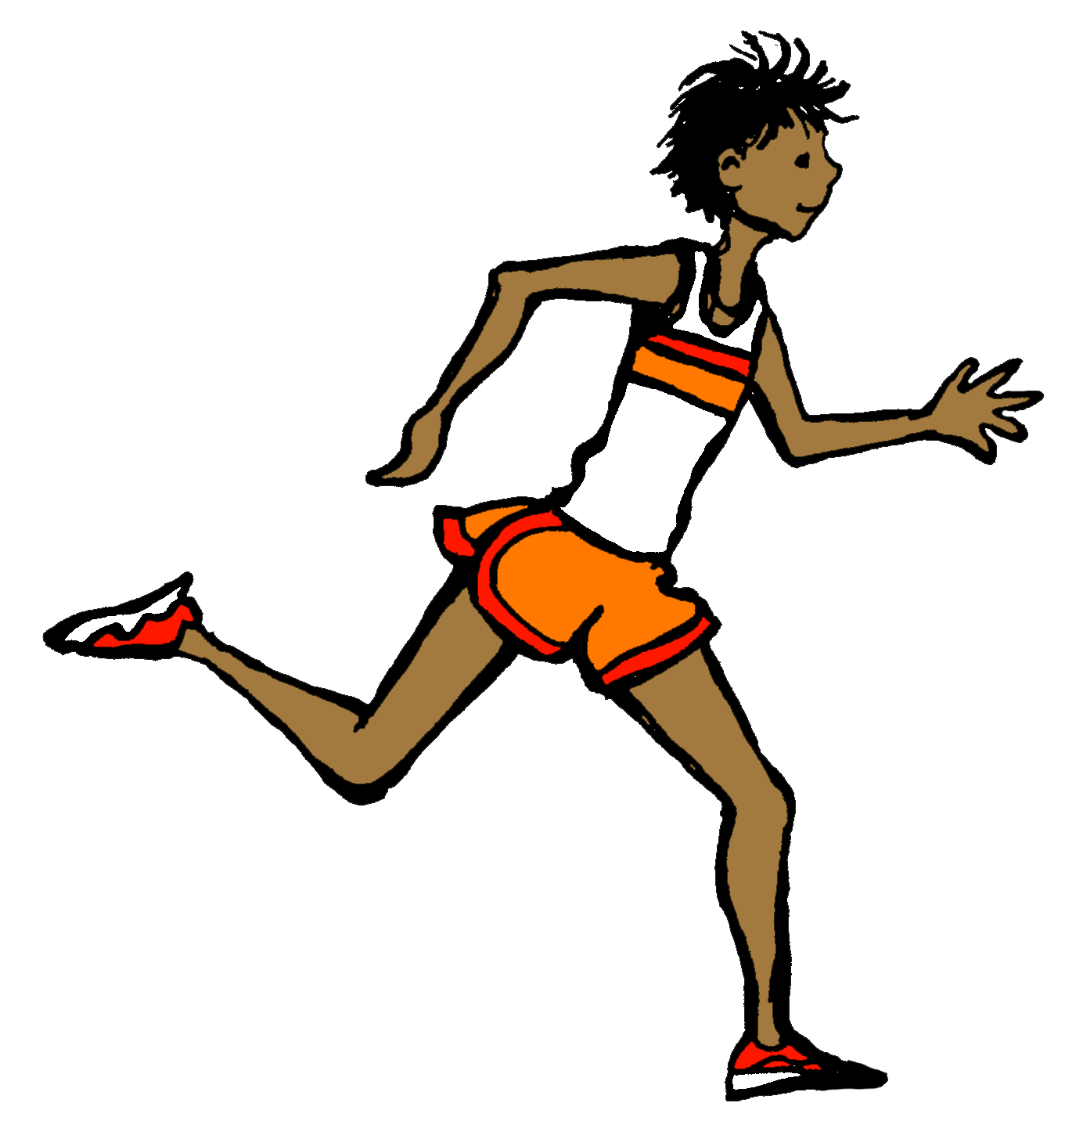
Dreaming big and running faster! Flying higher!

Slide 8
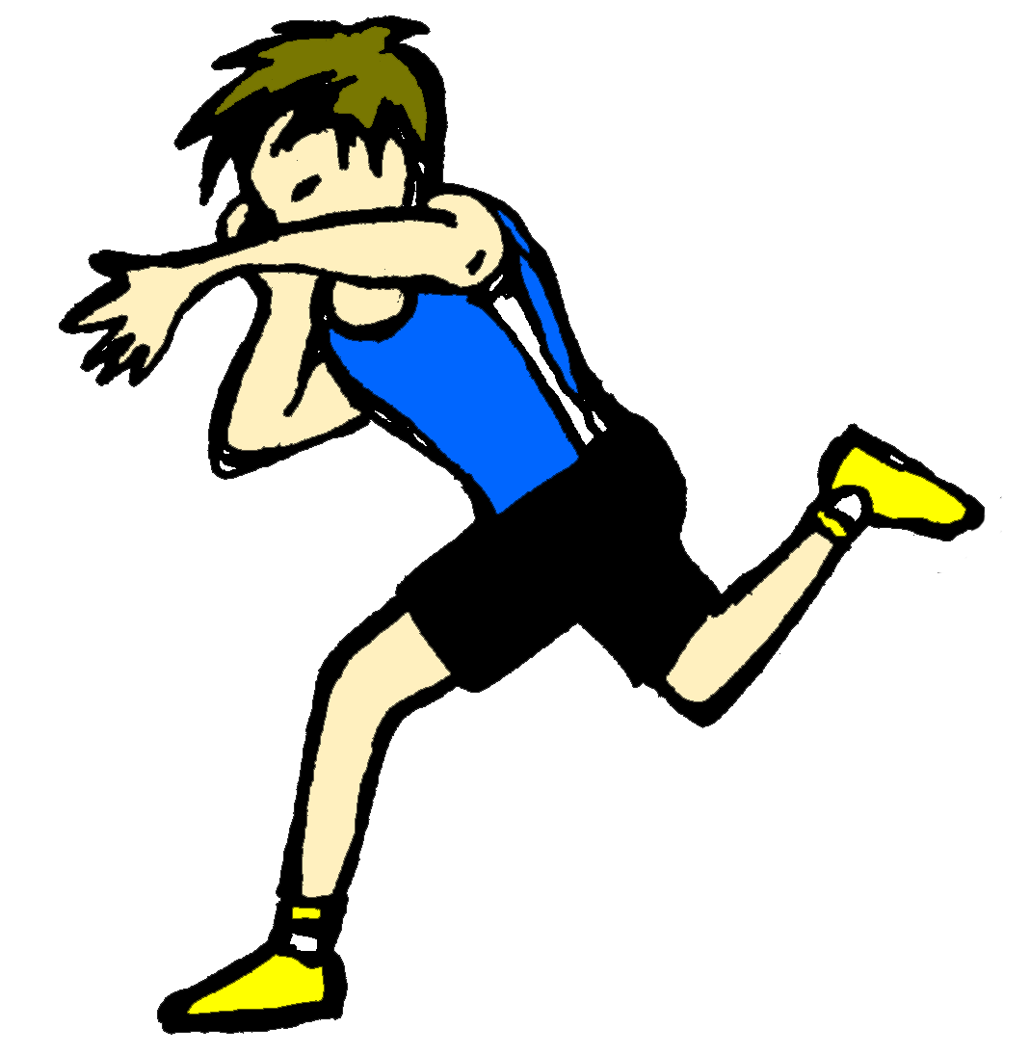
See just how far we can go!

Slide 9
For the games! For our national pride!

Slide 10
Gotta prove it to ourselves!

Slide 11
For the joy! Overcoming the odds!

Slide 12
And our journey to greatness begins!

Slide 13
Yes, our journey to greatness begins!

Slide 14
Oh! Oh!

Slide 15
All the world is tuning in to watch. Pageantry and majesty.

Slide 16
All our preparation paying off.

Slide 17
Be the best that we can be.

Slide 18
We are training smarter. Growing stronger.

Slide 19
Dreaming big and running faster! Flying higher!

Slide 20
See just how far we can go!

Slide 21
For the games! For our national pride!

Slide 22
Gotta prove it to ourselves!

Slide 23
For the joy! Overcoming the odds!

Slide 24
And our journey to greatness begins!

Slide 25
Yes, our journey to greatness begins!

Slide 26
Oh! Our journey to greatness begins!

